Slide 1
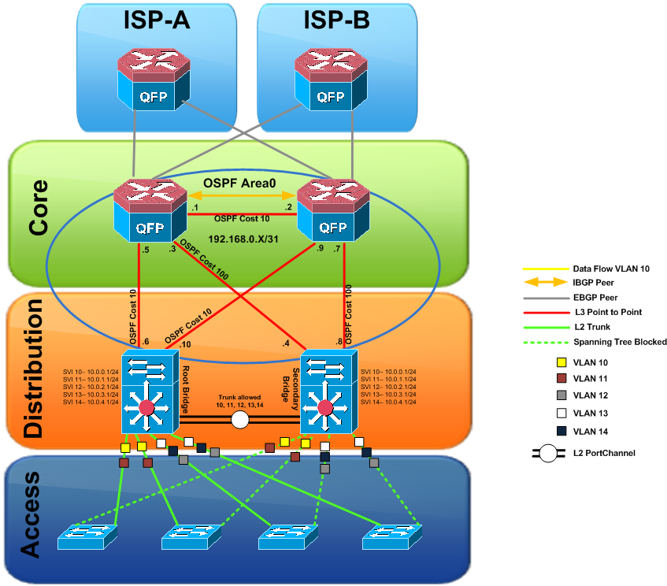
STP: Spanning-Tree Protocol
Sw1

Slide 2


STP: Loop Topology
DS1
DS2
Sw1
Sw2
F0/2
F0/3
F0/1
F0/2
Sw3
ffff.ffff.ffff

Slide 3

STP: Prevent Loop
Internet
Network
Internet
Network
Sw1
Sw2
F0/1
F0/2
Sw3
ffff.ffff.ffff

Slide 4
STP: Prevent Loop
Internet
Network
Internet
Network
Sw1
Sw2
F0/2
Sw3
ffff.ffff.ffff

Slide 5

STP Progress
Root Bridge
  bridge-id (priority + MAC)
Root Port
  RPC (Root Path Cost)
  bridge-id
  port-id
Designated Port
  RPC of Root Port
  bridge-id (priority + MAC)
Alternated Port (Block Port)
4096
4096
0000.0000.1111
Sw1
Sw2
Sw3
32768
0000.0000.2222
32768
0000.0000.3333
Sw(config)# spanning-tree vlan 1 priority 32768

Slide 6



BPDU: Bridge Protocol Data Unit
Root Bridge
  bridge-id (priority + MAC)
Root Port
  RPC (Root Path Cost)
  bridge-id
  port-id
Designated Port
  RPC of Root Port
  bridge-id (priority + MAC)
Alternated Port
4096
32768
0000.0000.1111
Sw1
Sw2
Sw3

Slide 7
STP Progress: Root Port
Internet
Network
Root Bridge
  bridge-id (priority + MAC)
Root Port
  RPC (Root Path Cost)
  bridge-id
  port-id
Designated Port
  RPC of Root Port
  bridge-id (priority + MAC)
Alternated Port
Root
Bridge
Sw1
RootPort
RPC=4
F0/1
RPC=8
Sw2
F0/2
Sw3

Slide 8
STP Progress: Root Path Cost
Internet
Network
Root Bridge
  bridge-id (priority + MAC)
Root Port
  RPC (Root Path Cost)
  bridge-id
  port-id
Designated Port
  RPC of Root Port
  bridge-id (priority + MAC)
Alternated Port
Root
Bridge
Sw1
RootPort
RPC=4
F0/1
F0/1
Cost=4
RPC=8
Sw2
F0/2
Sw3
Cost=4
Switch# show spanning-tree
Interface Role Sts Cost Prio.Nbr Type
-------- ----- --- --- -------- ----
Fa0/1 Desg FWD 19 128.1 P2p
Gi0/1 Desg FWD 4 128.2 P2p

Slide 9
STP Progress: Root Path Cost
Internet
Network
Root Bridge
  bridge-id (priority + MAC)
Root Port
  RPC (Root Path Cost)
  bridge-id
  port-id
Designated Port
  RPC of Root Port
  bridge-id (priority + MAC)
Alternated Port
Root
Bridge
Sw1
RPC=20
F0/1
Cost=4
interface f0/1
spanning-tree vlan 1 cost 20
RPC=8
Sw2
F0/2
Sw3
Cost=4
RootPort

Slide 10
STP Progress
Root
Bridge
Root Bridge
  bridge-id (priority + MAC)
Root Port
  RPC (Root Path Cost)
  bridge-id
  port-id
Designated Port
  RPC of Root Port
  bridge-id (priority + MAC)
Alternated Port
Sw1
Sw2
bridge-id
bridge-id
Sw3
8192
0000.0000.2222
12288
0000.0000.3333
RootPort
F0/2
Sw4
F0/3

Slide 11
STP Progress
Root
Bridge
Root Bridge
  bridge-id (priority + MAC)
Root Port
  RPC (Root Path Cost)
  bridge-id
  port-id
Designated Port
  RPC of Root Port
  bridge-id (priority + MAC)
Alternated Port
Sw1
bridge-id
Sw2
Sw3
F0/1
F0/2
Sw2# show spanning-tree interface f0/1
Port 1 (FastEthernet0/1) of VLAN1 is forwarding
Port path cost 19, Port priority 128, Port Identifier 128.1
F0/2
RootPort
Sw4
F0/4

Slide 12
STP Progress: Port Role
Root Bridge
  bridge-id (priority + MAC)
Root Port
  RPC (Root Path Cost)
  bridge-id
  port-id
Designated Port
  RPC of Root Port
  bridge-id (priority + MAC)
Alternated Port
Root
Bridge
Sw1
D.Port
D.Port
RootPort
F0/1
RootPort
RPC of RP
1
RPC of RP
Sw2
F0/3
F0/2
Sw3
bridge-id
D.Port
bridge-id
8192
0000.0000.2222
12288
0000.0000.3333
2

Slide 13
STP Progress: Hello Timer 2s
Root Bridge
  bridge-id (priority + MAC)
Root Port
  RPC (Root Path Cost)
  bridge-id
  port-id
Designated Port
  RPC of Root Port
  bridge-id (priority + MAC)
Alternated Port
Root
Bridge
Sw1
RootPort
RootPort
Sw2
F0/2
Sw3
F0/3
PC2
PC3

Slide 14
STP Progress: Hello Timer 2s
Root Bridge
  bridge-id (priority + MAC)
Root Port
  RPC (Root Path Cost)
  bridge-id
  port-id
Designated Port
  RPC of Root Port
  bridge-id (priority + MAC)
Alternated Port
Root
Bridge
Sw1
RootPort
RootPort
Sw2
Sw3
F0/3
PC2
PC3

Slide 15
STP Progress: Hello Timer 2s
Root Bridge
  bridge-id (priority + MAC)
Root Port
  RPC (Root Path Cost)
  bridge-id
  port-id
Designated Port
  RPC of Root Port
  bridge-id (priority + MAC)
Alternated Port
Root
Bridge
Sw1
RootPort
Max-age Timer 20s
Sw2
F0/2
Sw3
F0/3
PC2
PC3

Slide 16
STP: Port State
F0/2
Disable
Blocking
Listening
Learning
Forwarding
20s
Max-age
15s
Forward delay
15s
Forward delay

Slide 17
STP: Port State
MAC Table
Packet
H
Y
f0/1
S
Packet
S
D
f0/1
Y
f0/1
X
Tx BPDU
Rx BPDU
Disable
Blocking
Listening
Learning
Forwarding
Rx BPDU
Rx BPDU Tx BPDU
Rx BPDU Tx BPDU LRN MAC
Rx BPDU Tx BPDU LRN MAC FWD frame

Slide 18

STP: Port Fast
Disable
Blocking 0s
Listening 15s
Learning 15s
Forwarding
interface f0/1
spanning-tree portfast
Disable
Forwarding

Slide 19

STP vs PVST+
Sw1
trunk
Sw2
VL1
VL2
VL1
VL2
trunk
trunk
F0/2
VL1
VL2
Sw3

Slide 20
PVST: PerVLAN Spanning-tree
Sw1
Root
Root
Sw2
trunk
VL1
VL2
trunk
VL1
VL2
trunk
trunk
F0/1
F0/2
VL1
VL2
Sw3

Slide 21
PVST: PerVLAN Spanning-tree
STP
Bridge
Priority
MAC Address
Bridge
Priority
PVST+
Bridge Priority
VLAN ID
12 bit
MAC Address

Slide 22
PVST: PerVLAN Spanning-tree
STP
32768
MAC Address
32768+1
PVST+
32768
VLAN ID
12 bit
MAC Address
32768+4096

Slide 23

PVST: PerVLAN Spanning-tree
32768
1
0
0
0
4096
1
0
0
1
Bridge Priority
VLAN ID
12 bit
MAC Address

Slide 24
PVST: PerVLAN Spanning-tree
Switch# show spanning-tree vlan 30
VLAN0030
Spanning tree enabled protocol ieee /pvst+
Root ID Priority 24606
Address 00d0.047b.2800
This bridge is the root
Hello Time 2 sec Max Age 20 sec Forward Delay 15 sec
Bridge ID Priority 24606 (priority 24576 sys-id-ext 30)
Address 00d0.047b.2800
Hello Time 2 sec Max Age 20 sec Forward Delay 15 sec
Aging Time 300
Interface Role Sts Cost Prio.Nbr Type
-------- ----- --- --- -------- ----
Gi1/1 Desg LIS 4 128.1 P2p
Gi1/2 ALT BLK 4 128.2 P2p
Gi5/1 Desg LRN 4 128.257 P2p
Gi5/2 Desg FWD 4 128.258 P2p

